Slide 1
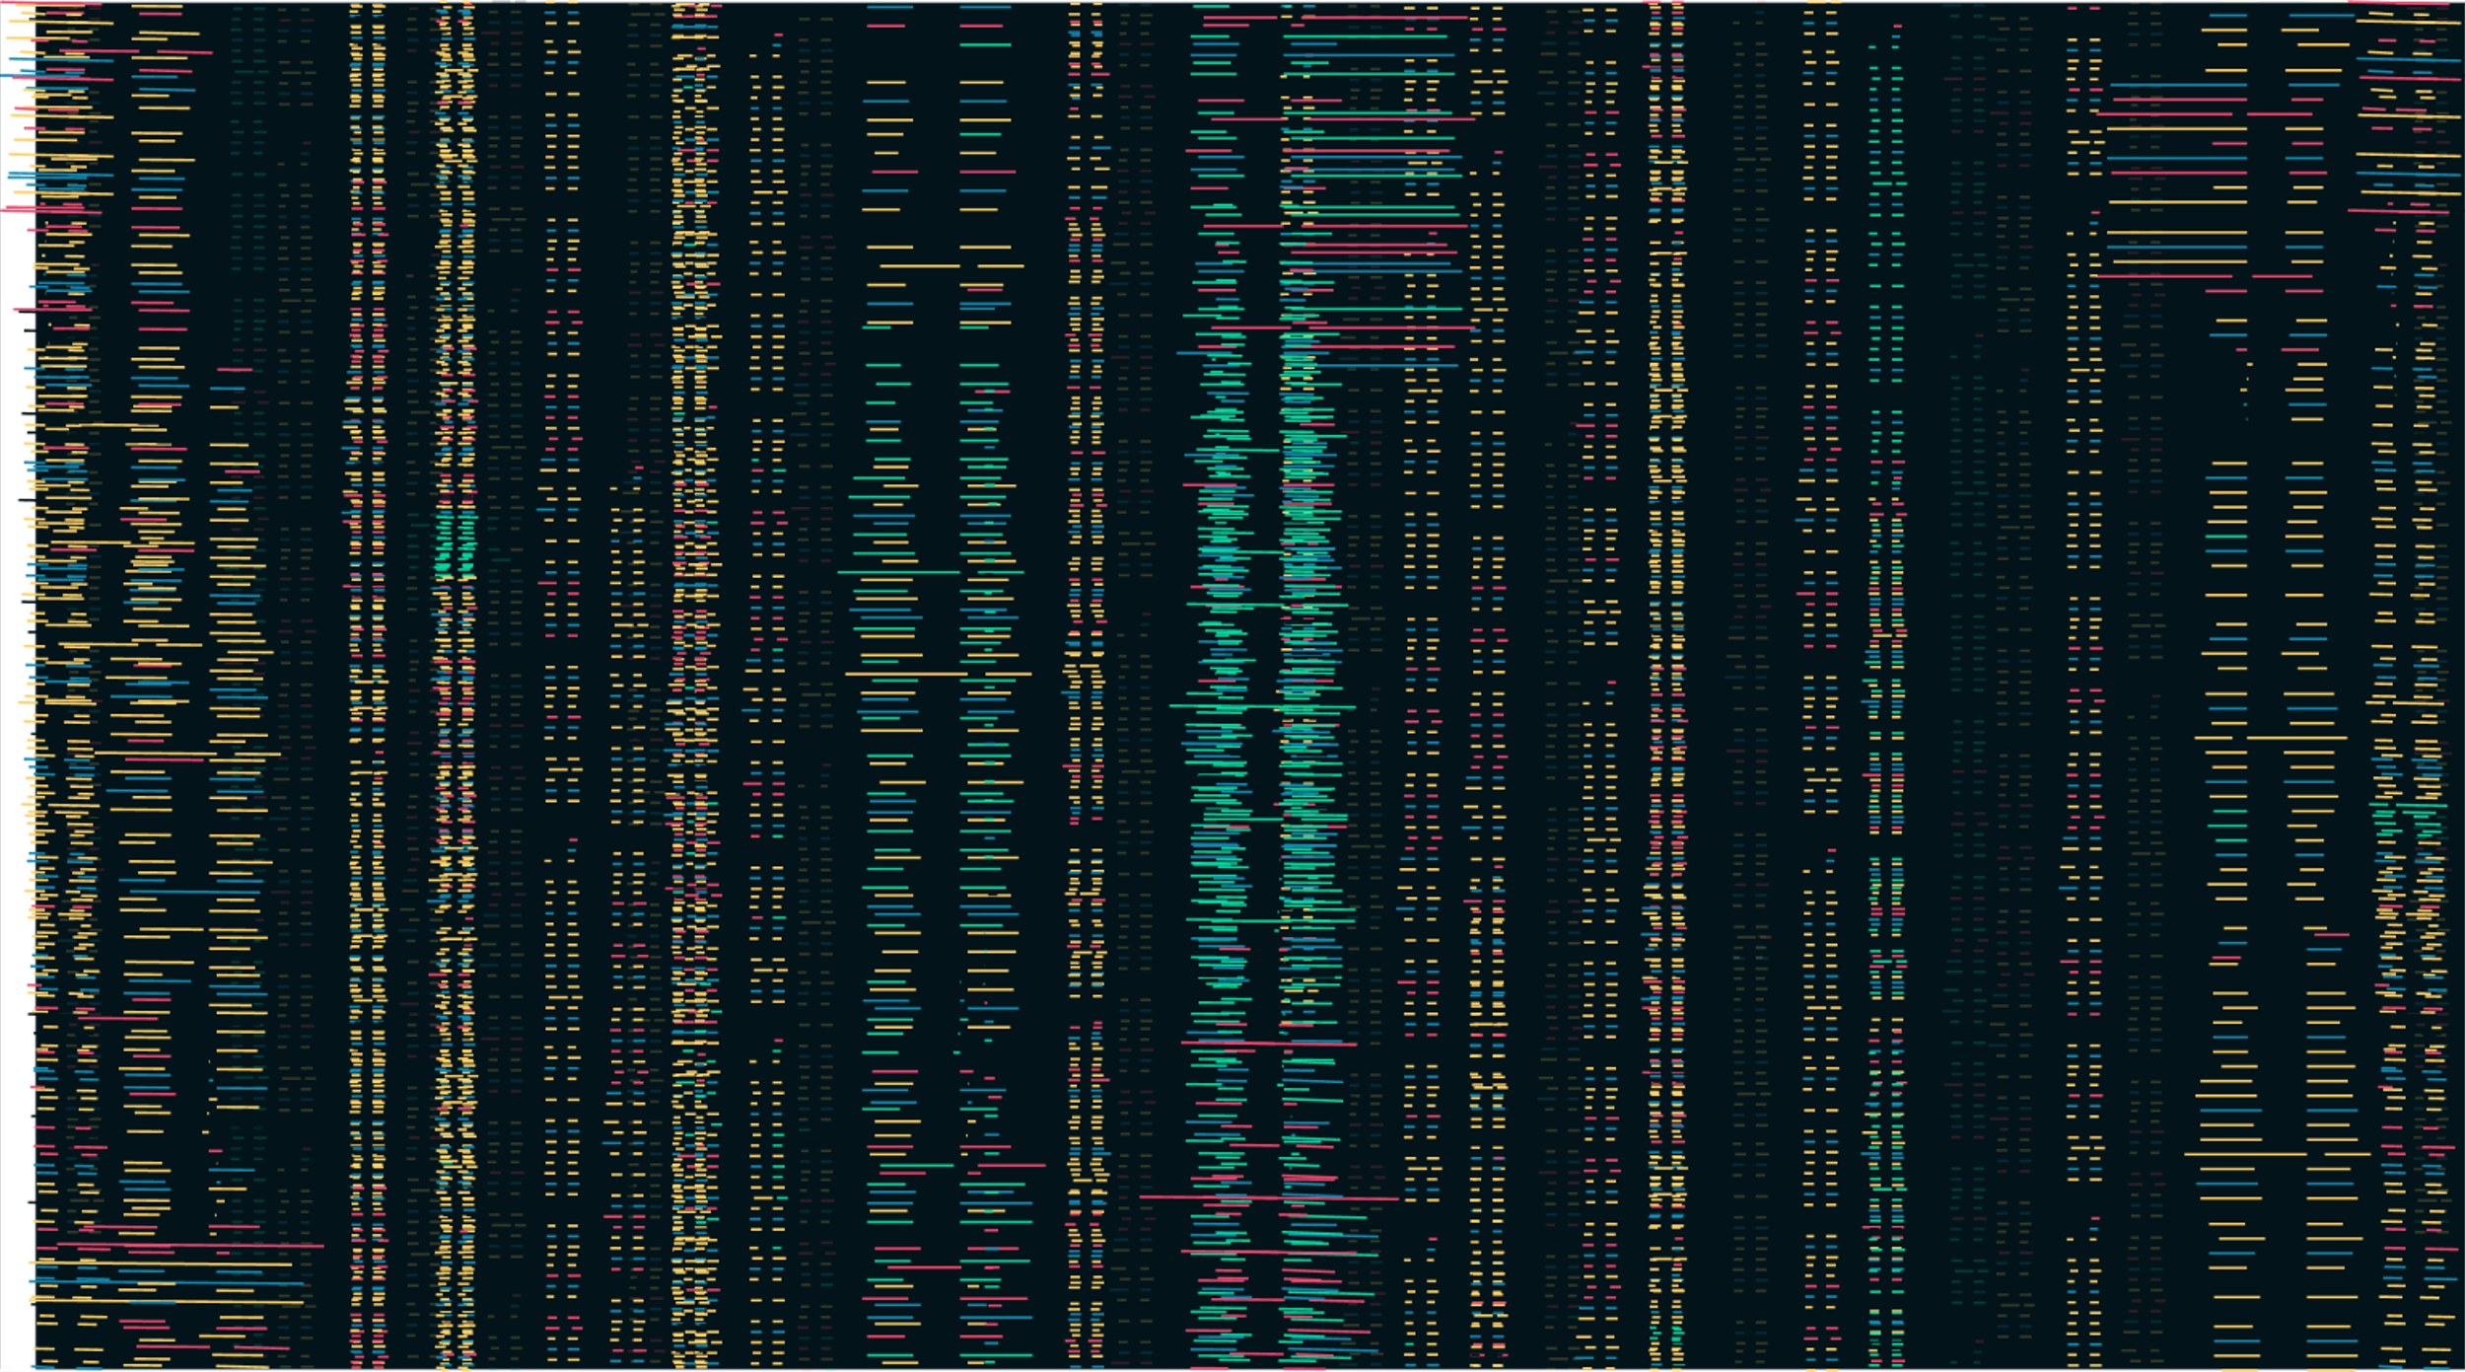

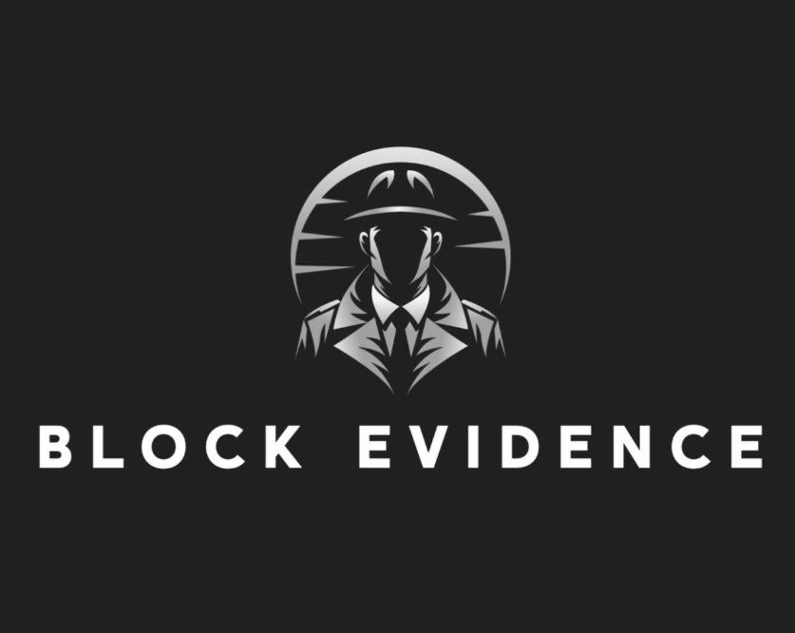
Block Evidence
Nithin Raj [1015116216]
Nodirbek Islomov [101503673]
Harold Felipe Lara [101532704]

Slide 2

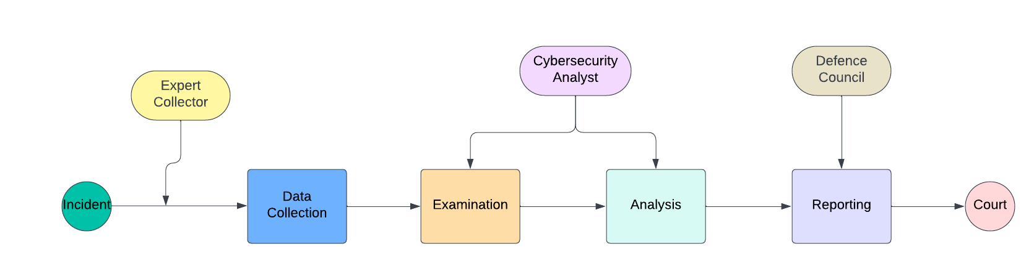
Chain of Custody?

Slide 3



Problem statement
In digital forensics, preserving the integrity and authenticity of digital evidence is crucial. Current methods for handling and storing digital evidence have vulnerabilities that can lead to unauthorized access, and tampering, which can undermine legal proceedings and lead to wrongful convictions.
Flaws in the security of proof not only compromise the effectiveness of legal proceedings but also pose a severe risk of miscarriages of justice for those handling the evidence and those involved in the events.

Slide 4
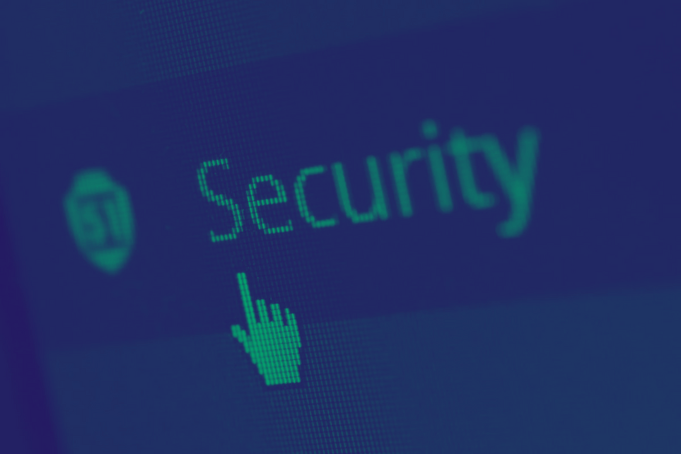
Solution
Ensure the integrity, security, and transparency of digital evidence.
Utilize blockchain to create immutable and tamper-proof records of all digital evidence.

Slide 5
S
W
O
T
STRENGTHS
WEAKNESSES
OPPORTUNITIES
THREATS
Security.
Efficiency.
Transparency and Trust.
Complex Technology.
Reliance on Ethereum.
Storage
Partnerships.
Cybersecurity Market.
Technological Progressions.
Regulatory Changes
Resistance to Change
Security Vulnerabilities

Slide 6
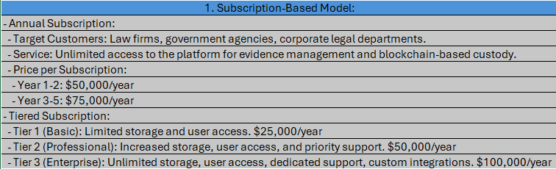


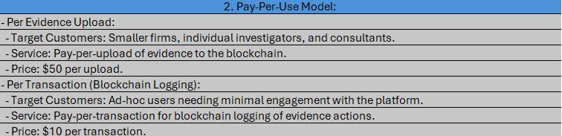

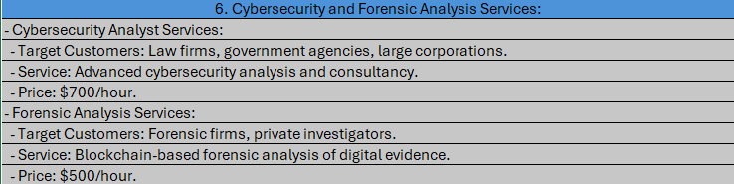
Business Model

Slide 7
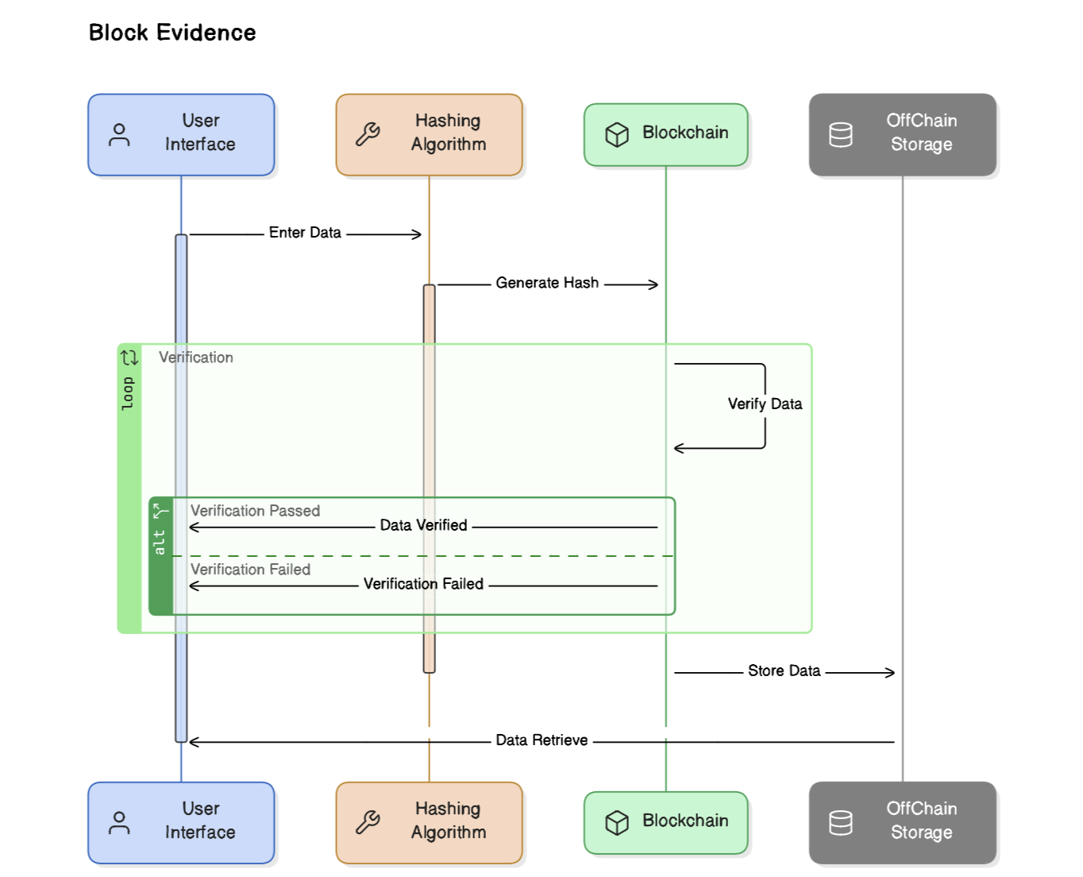
Architecture

Slide 8

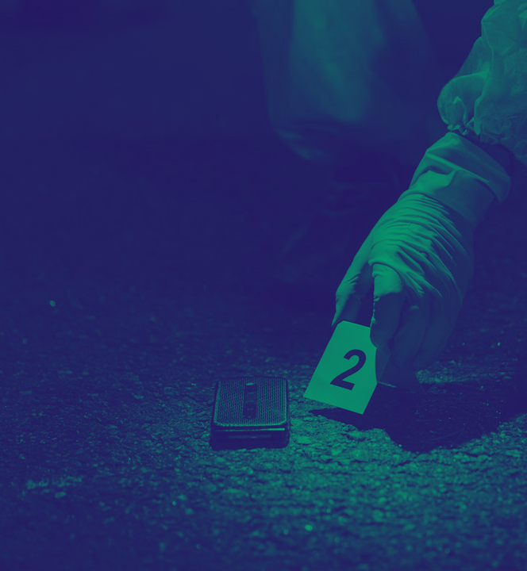



Demo

Slide 9


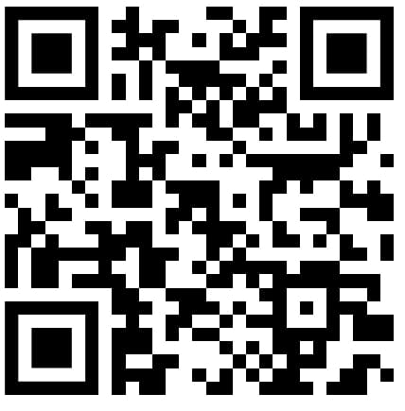
THANK YOU
Contact us

